Slide 1
405 Project Group 3
Murtada Al Hasan
Khaled Al Badeea
Mohammed Al Sulayyim
Mohammed Al Ghamdi

Slide 2
Content
The Problem
System Description
01
04
Objectives
Initial Assumptions
02
05
Scope
Input Data Analysis
03
06
An Introduction to the Project
Breif Explanation of the system
Data Assumptions, Structural Assumptions and Logical Assumptions
What we are trying to achieve
What is the wideness of the project
How did we analyised and obtained the data

Slide 3
Content
Arena Model
Scenarios
07
10
Validation
Recommendations
08
11
Output Analysis
09
Simulation Model that representa the real system
Improving the real life system by conduction several tests on the model
Based on the Output analysis and the scenarios
Making sure that the model has the same behavior of the real system
Making sure that the output is logical and the number of replications are enough

Slide 4
MISSION STATEMENT
The Problem
A new Concept!!
Tiny Fields

Slide 5
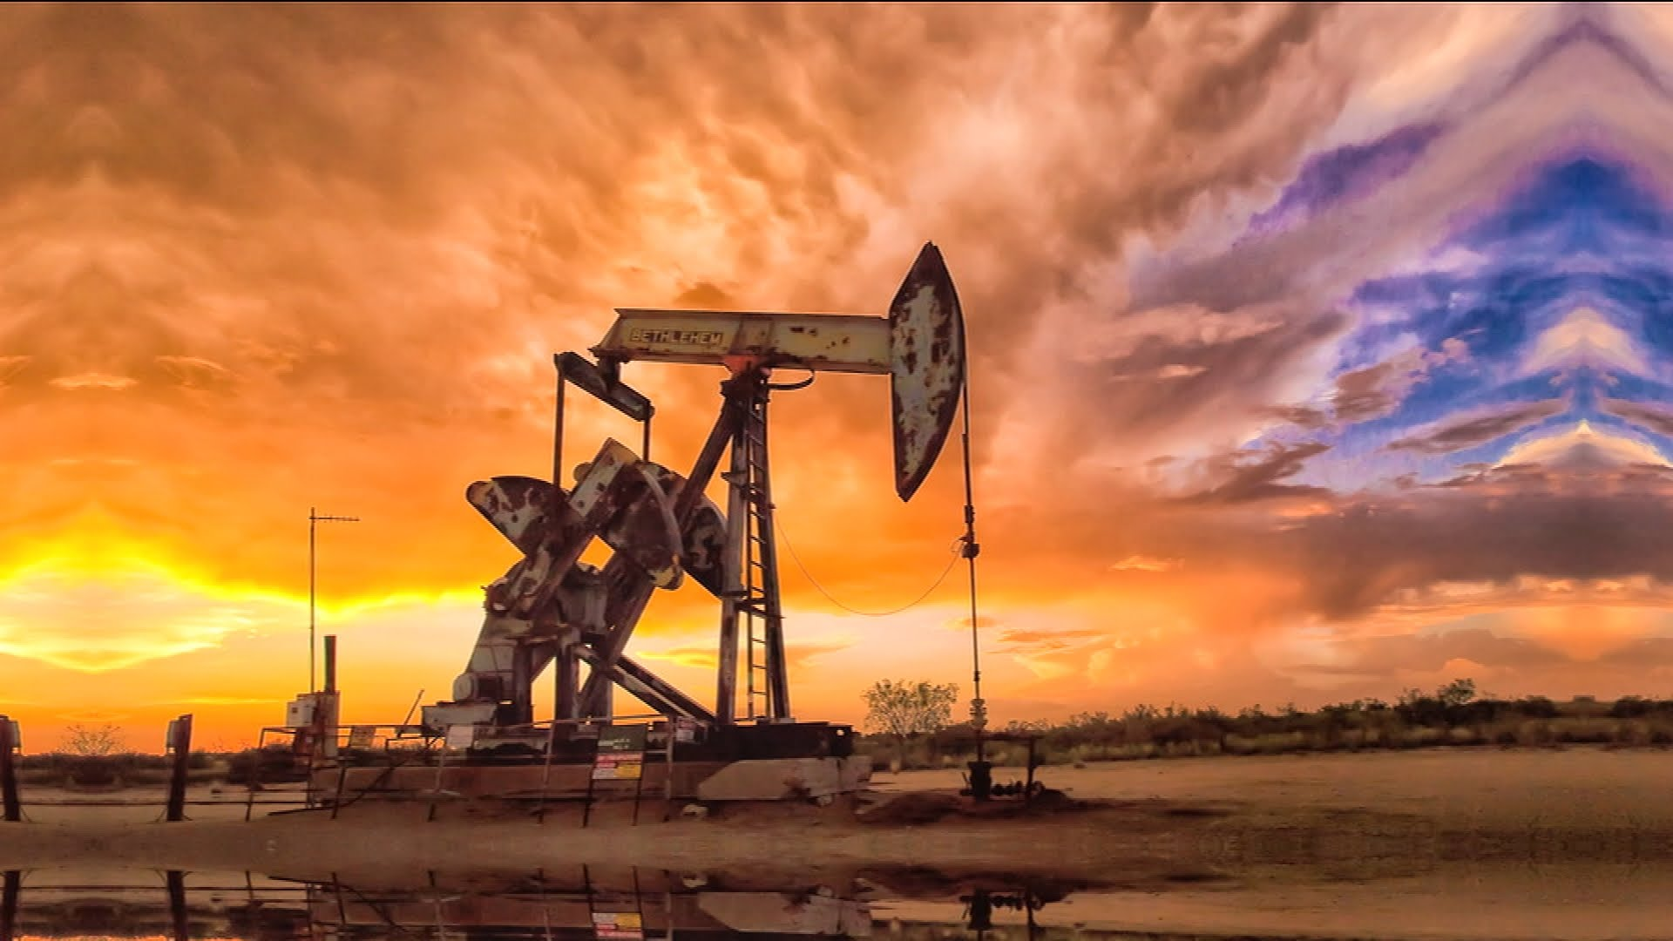
The Problem
Aramco Production
Shayba Field Production
Our Tiny Field Production

Slide 6
The Problem
1
1
2
Distillation
3
2
Cracking
3
Blending

Slide 7
Objectives
Too Expensive!!
Applying several scenarios in the model instead
Maximize the Company Profit
Testing the efficiency of the new concept

Slide 8
Scope of The Project
These days, oil and its derivatives are one of the most important things. Many products are depending on the oil.
Oil companies always want to find new profitable oilfields, with a large amount of oil.
However, some oilfields are not profitable and might have unwanted consequences.
If an oil company wants to check if a new oilfield will be profitable, simulation is an efficient tool to test and check a model for many scenarios before building it physically.

Slide 9
System Description
The system consists of three main steps
Distillation
Cracking
Blending
1
2
3

Slide 10
Distillation
Distillation has three subparts:
distillation column.
Condenser.
reflux drum.
The oil that is extracted is a mixture of many components and need to be separated.
The crude oil separated based on:
Volatility.
the boiling point. (up to 600 degrees Celsius)
The mixture boiled and forms gases that will go to the vapor phase with the lowest boiling point.
The liquid and solid parts will be separated according to their boiling points.
The liquid will go to the condensers.
In the condensers, the liquid will be cooled again the be transported either to the cracker or directly to the blender through the reflux drum by a specified ratio of crude oil.

Slide 11
Cracking
The crude oil most be liquid by breaking the carbon-carbon bonds by heating them in high temperature (around 816º C) and throw away the solids that cannot be transformed to liquids.

Slide 12
Blending
In the blending step, we have three different products from each process (distillation and cracking) with the same ON (82 or 98) but different in price.
In blending step, we need to have finally three types of ON with the lowest price (87, 89, 92), by combining two products from each previous step to have the final three products.

Slide 13
Initial Assumptions:
FIFO
01
The whole amount of crude oil that is arrived by a single truck is considered as one entity.
04
02
Crude oil is arrived by trucks.
Xij is divided instantaneously during the processes.
05
03
Each truck can carry 190 bbl.
The system services the entities that come first.

Slide 14
Initial Assumptions:
The distribution of a processing time
The cracking process is done by a single step.
06
08
The initial distribution of the crude oil
Tiny field
07
09
can be divided into partial sub-processes times, where the summation of the distribution parameters in the sub-processes is equal to the parameters in the main process.
This simulation model for the tiny field is general and applicable for any other tiny fields (e.g. 20 tiny fields can be built instead of normal field with the same simulated model to minimize the risk of building the huge field).
is equal for each one of blends through the three sequences (33.33% for each).

Slide 15
IA
INPUT DATA AND ITS ANALYSIS

Slide 16
DATA TYPE
Arrival Time
Distillation Time
01
02
Cracking Time
Blending Time
03
04
Assumed to be exponential
Possible Data
Assumed to be random
Known to be random

Slide 17
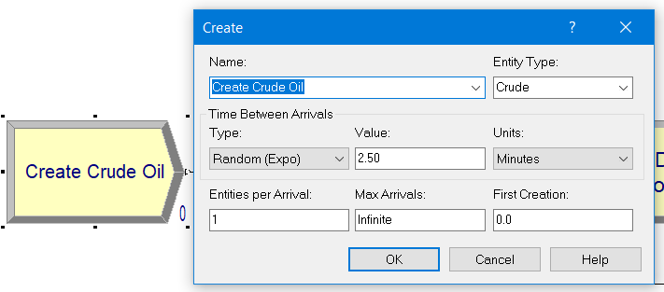
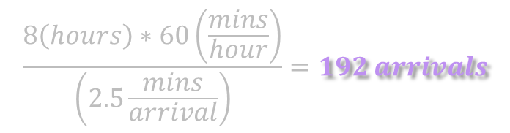
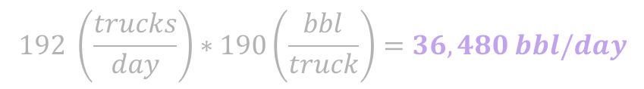
MISSION STATEMENT
Arrival Time EXPO( 2.5 )
Aim
Utilize the capacity as much as we can
(40,000 bbl)
$$\frac{8\left(hours\right)∗60\left(\frac{mins}{hour}\right)}{\left(2.5\frac{mins}{arrival}\right)}=192 arrivals$$
It was determined by logical calculations
$$192 \left(\frac{trucks}{day}\right)∗190\left(\frac{bbl}{truck}\right)=36,480 bbl/day$$

Slide 18
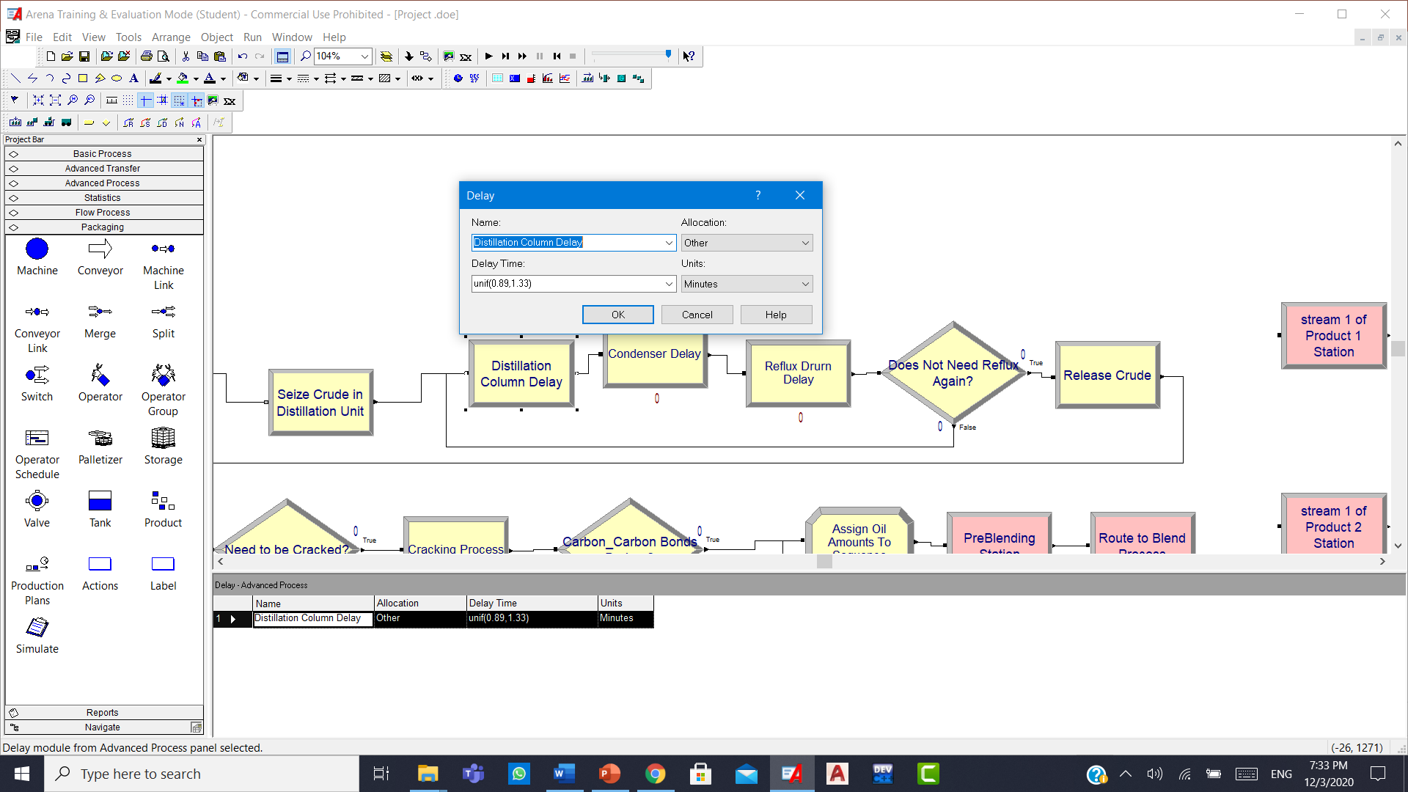
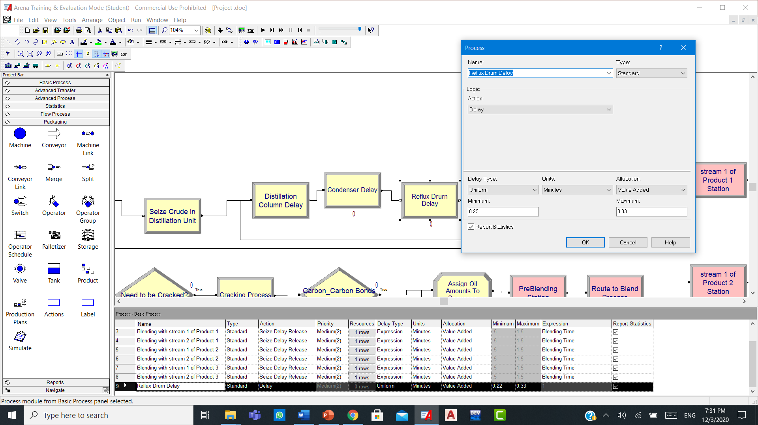
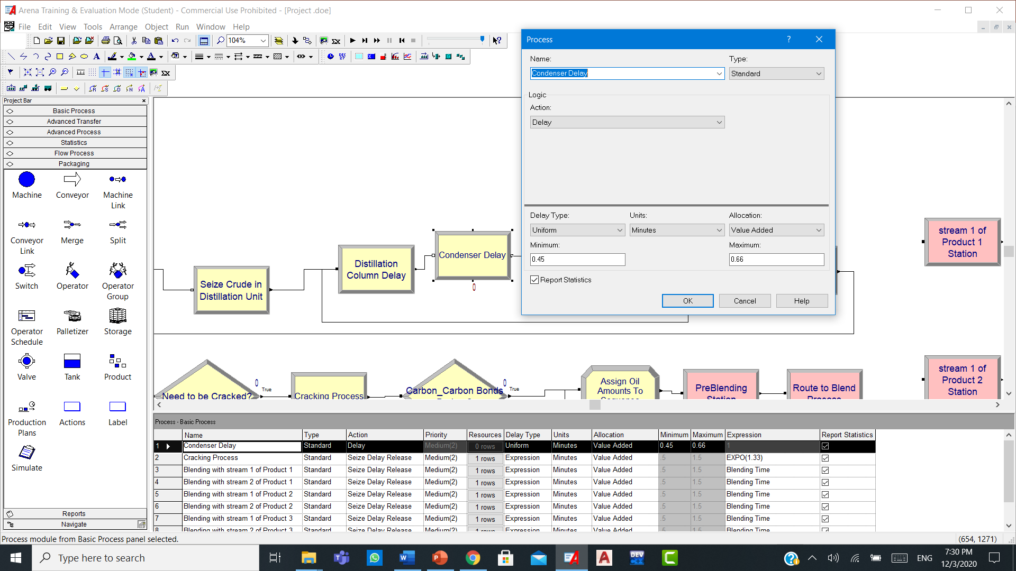

MISSION STATEMENT
Distillation Time UNIF(1.56,2.32)
Estimation
Distillation time is 153 times less
$$UNIF\left(\frac{4\left(hours\right)∗60\left(\frac{mins}{hour}\right)}{153}, \frac{6\left(hours\right)∗60\left(\frac{mins}{hour}\right)}{153}\right)$$
$$≈UNIF\left(1.56, 2.32\right) mins$$
It was determined by knowing that distillation can take around
4 to 6 hours
Divided into smaller processes
$a_{1}+a_{2}+a_{3}=1.56 mins, b_{1}+b_{2}+b_{3}=2.32 mins$

Slide 19
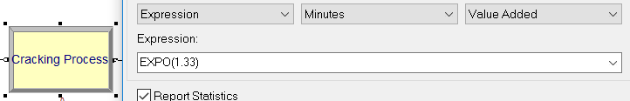

MISSION STATEMENT
Cracking Time EXPO( 1.33 )
Recall
our tiny field we simulated is
(153 times) less than usual field
$$EXPO\left(\frac{3.4\left(hours\right)∗60\left(\frac{mins}{hours}\right)}{153}\right)$$
$$≈EXPO\left(1.33\right) mins$$
Known to be completely random, and it is around
3.4 hours

Slide 20
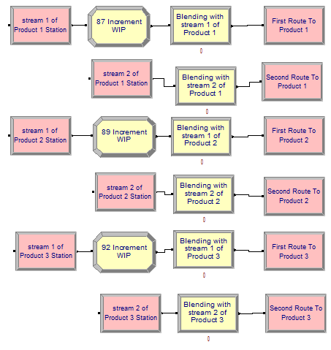


MISSION STATEMENT
Blending Time EXPO( 0.55 )
$$EXPO\left(\frac{1.15−0.05}{2}\right)mins$$
$$≈EXPO\left(0.55\right) mins$$
$$E_{t}=1.15 mins$$
Including the transfer time
TT = 0.05
So
The blending time in a single stream

Slide 21
AR
ARENA MODEL The model is built carefully, covering the whole process of Distillation, Cracking, and Blending

Slide 22
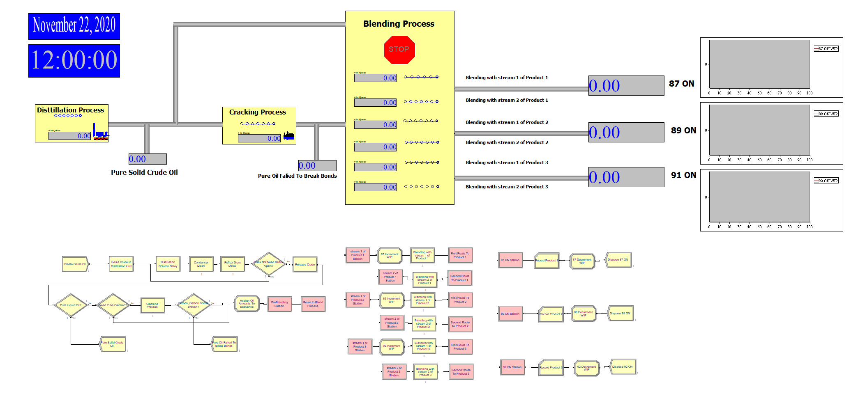
ARENA MODEL

Slide 23
V
Validation

Slide 24
Validation
High Face Validity
01
Model Assumption Validation
02
By an expert
Sensitivity Analysis
Data Assumptions
Structural Assumptions

Slide 25
MISSION STATEMENT
High Face Validity
We asked Dr. Rahul N. Gajbhiye
Assistant Professor in the College of Petroleum Engineering and Geosciences at KFUPM
An expert in the downstream of the crude oil refinery which we are simulating (downstream includes Distillation, cracking and blending).
By an expert

Slide 26
MISSION STATEMENT
High Face Validity
Decreasing ratio of reflux | Increasing waiting time | Increasing queue length
Increasing ratio of distillation | Decreasing the total time | Decreasing # of units out
Decreasing ration of pre-cracking | Decreasing the utilization | Increasing the # of units out
Increasing blending time | Increasing the utilization | Increasing the total time
Sensitivity Analysis
To have Logical results that matches with real life crude oil system

Slide 27
MISSION STATEMENT
Model Assumption Validation
Structural Assumptions

Slide 28
MISSION STATEMENT
Model Assumption Validation
Structural Assumptions

Slide 29
MISSION STATEMENT
Model Assumption Validation
Distribution | Process | Why?
Uniform | Distillation | Max, and Min values ONLY
Exponential | Trucks arrival time | Common in arrival events
Exponential | Cracking & Blending | Complete of them completely random
Data Assumptions

Slide 30
0A
OUTPUT ANALYSIS

Slide 31
Assumptions
Maximum allowable error of time is 1 min.
The waiting time in the real system is 4.25 min.
The total time in the real system is 6.4 min.
The time in the queue of the distillation unit in the real system is 3.2 min.
Maximum allowable error of the number of oil trucks is 25 trucks.
The number of oil trucks entered in the real system is 1030 trucks.
Maximum allowable error of WIP is 0.45.
The value of WIP in the real system is 2.3.
Maximum allowable error of utilization is 0.075.
The utilization of the distillation unit in the real system is 0.75.
The utilization of the blending machine and cracker in the real system is 0.06.

Slide 32
OUTPUT ANALYSIS
Waiting Time
01
02
Time is the distillation queue
03
Total Time
Average: 3.82 min
Half width: 0.32
C.I.: (3.50, 4.14)
0.32 < 1
Average: 6.12 min
Half width: 0.32
C.I.: (5.8, 6.44)
0.32 < 1
# of oil trucks entered the system
04
Average: 3.81 min
Half width: 0.32
C.I.: (3.49, 4.13)
0.32 < 1
Average: 1053.73
Half width: 13.82
C.I.: (1039.91, 1067.55)
13.82 < 25

Slide 33
OUTPUT ANALYSIS
WIP
05
06
Utilization: Blending machine
Utilization: Cracker
07
08
Utilization: Distillation unit
Average: 2.45
Half width: 0.15
C.I.: (2.3, 2.6)
0.15 < 0.45
Average: 0.7881
Half width: 0.01
C.I.: (0.7781, 0.7981)
0.01 < 0.075
Average: 0.0550 *
Half width: ~0.00
~0.00 < 0.075
Actual =$0.0550∗\frac{153}{10}=0.84150$
Average: 0.0647 *
Half width: ~0.00
~0.00 < 0.075
Actual = $0.0647∗\frac{153}{10}=0.98991$

Slide 34
MISSION STATEMENT
Number of Trucks
Each Truck can carry
190 bll of oil
$$1052\left(\frac{trucks}{week}\right)∗\left(\frac{1week}{5days}\right)∗190\left(\frac{bbl}{truck}\right)=39,976 \frac{bbl}{day}$$
$$\left(\frac{39,976\left(\frac{bbl}{day}\right)}{40,000\left(\frac{bbl}{day}\right)}\right)∗100\%=99.94\%$$

Slide 35
Scenarios and Improvements on The System

Slide 36
System Operations
Company Policies
Two Types Of the Scenarios
Adjusting the Distribution of the entites before blending
Adjusting the ratio of the entities to be cracked
Adjusting the working times policy

Slide 37
01
Adjusting the Distribution of the entites before blending

Slide 38
Before
After
The Distribution Initially was 33.33% for each Final Product
New Distribution is: 10% of (87 ON), 33.33% of (89 ON) and 56.67% (92 ON)
WHY??

Slide 39

Old Revenue
38,797,506

Slide 40
40,529,736 SR
The revenue increased by around 1.7 Million
Conclusion?

Slide 41
02
Adjusting the ratio of the entities to be cracked

Slide 42
Before
After
100% of the cracker capacity uesd
Represents 52.6% of the arrived entities
75% of the cracker is used
Represents 39.4% of the entities

Slide 43
Old Revenue
38,797,506 SR

Slide 44
42,620,382 SR
The revenue increased by around 3.8 Million
Conclusion?

Slide 45
03
Adjusting the working times policy

Slide 46
Before
After
The Daily working times are as follow:
4, 12, 12, 12, 4 hours
The daily Working timea are as follow:
8, 8, 8, 8, 8 hours

Slide 47
Old Revenue
38,797,506

Slide 48
35,240,220 SR
The revenue Decreased by around 3.56 Million
But, overtimes hours savings are around 2.64 Million
So the Total Lose is around 0.92 Million
Conclusion?

Slide 49
Contributions
We contributed in:
1- Increasing the annual revenue of the tiny field by adjusting distributing of items that go to the blending sequences
2- Increasing the annual revenue of the tiny field by adjusting the amount of oil that go to the cracking process
3- Supporting the company policy of using the (4 12 12 12 4) working hours system

Slide 50
R
RECOMMENDATION

Slide 51
Recomendation
We Recommend:
Running the simulation model with larger number of replications will give more accurate results.
Using the second system working hours (4 12 12 12 4) will have better net revenue to the company.
The third product (ON 92) have the best revenue, the company should increase it to have better net revenue (with considering other constrains)
Adjusting the ratio of the oil that comes from the distillation tower to the cracker will gives a better revenue to the company.

